Slide 1
Pandas: Data Structures, Reading and Writing

Slide 2
Basic introduction
pandas (Python Data Analysis Library) is a library specialized for data analysis and used a series of I/O API functions to read and write data as dataframe objects.
Python IDE (Integrated Development Environment):Jupyter Notebook or Spyder.
Easiest way to get Pandas set up is to install it through a package like the Anaconda distribution.
Primary data structures on which all transactions are centred (generally made during the analysis):
Series: Object of the library designed to represent one-dimensional data structure.
Dataframes: More complex data structure designed to contain cases with several dimensions.

Slide 3
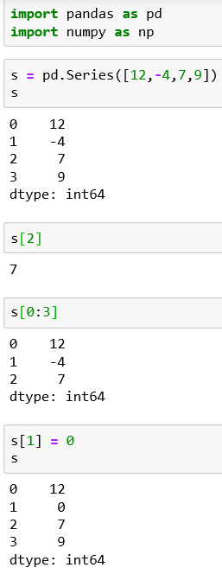
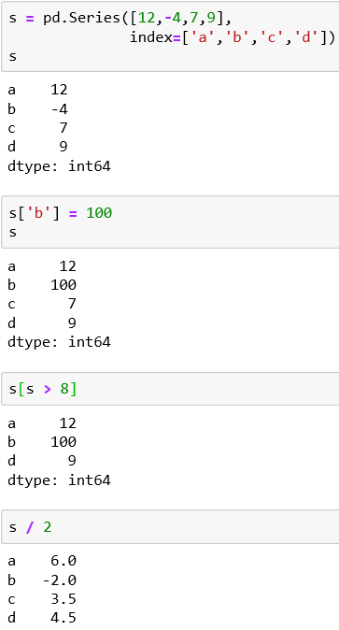
The Series
Declaring a series, assigning an index
Declaring a series
Assigning a value to an item using its label
Selecting one internal element
Selecting multiple elements
Filtering values
Assigning a value to an item using its index.
Operators (+,-,* and /) and mathematical function that are applicable to NumPy array can be extended to Series

Slide 4
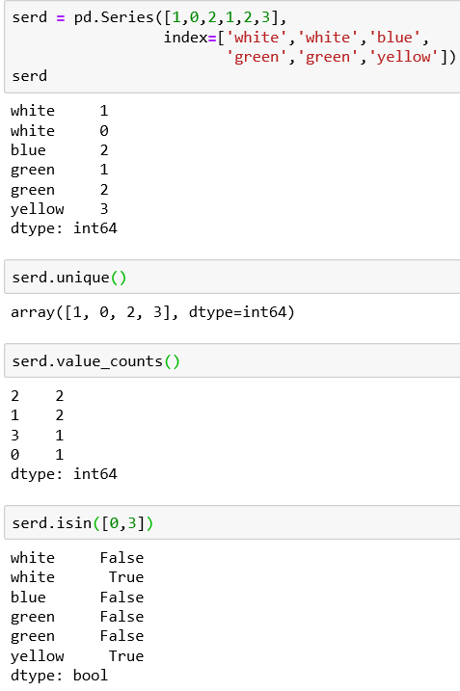
The Series – Evaluating Values
The unique () function will tell us all the values contained in a series, excluding duplicates
The value_counts() will return the unique values but also calculate the occurrences within a series.
The isin() function tells us if the values are contained in the data structure. Boolean values returned can be can be very useful when filtering data in a series or in a column of a dataframe.

Slide 5
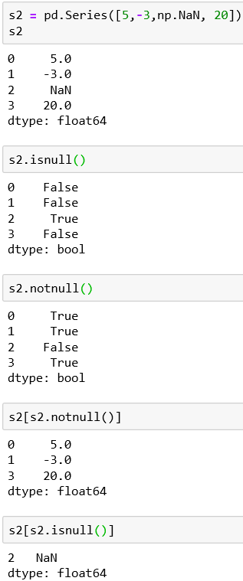
The Series – NaN Values
NaN (Not a Number) is used in pandas data structures to indicate the presence of an empty field or a non-numeric element. To define a missing value, we enter np.NaN.
The isnull() and notnull() functions are useful to identify the indexes without a value.
The isnull() returns True at NaN values in the series.
The notnull() returns True if they are not NaN.
These functions are often put inside filters to make a condition

Slide 6
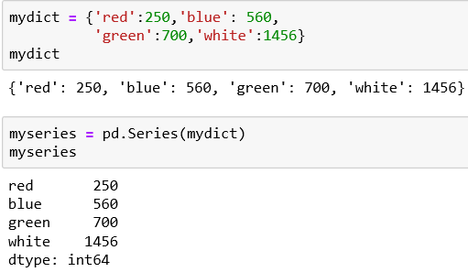
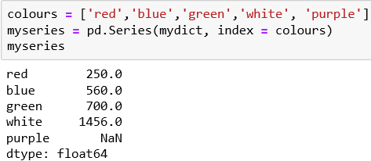
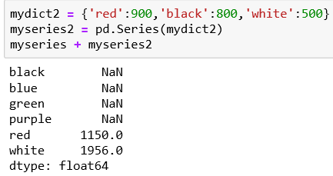
The Series
We can create a series from a previously defined dictionary. The array of the index is filled with the keys while the data are filled with their values.
We can also define the array indexes separately. As seen, if there is a mismatch, pandas will add the NaN value.
We can perform operations between two series. Series can align data addressed differently between them by identifying their corresponding labels.

Slide 7
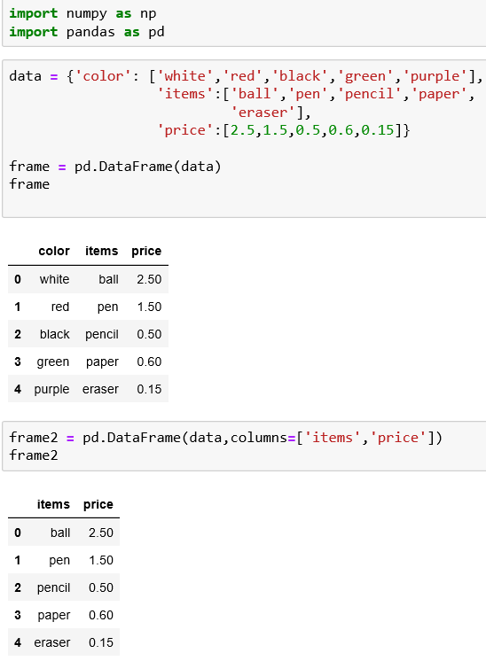
The DataFrame
Tabular structure very similar to a spreadsheet.
Designed to extend series to multiple dimensions.
Consists of an ordered collection of columns, each of which can contain a value of a different type (numeric, string, Boolean, etc.)
Unlike series which have an index array containing labels associated with each elements, the dataframe has two index arrays.
It can be understood as a dictionary of series where the keys are the column names and the values are the series that will form the columns of the dataframe
Define a dataframe
We can select the data we want to display. Use column option to specify the sequence of columns. dataframe

Slide 8
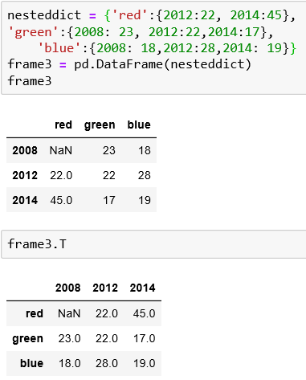
The DataFrame
A common data structure used in Python is a nested dict. When it is passed directly as an argument to the DataFrame() constructor, pandas will treat external keys as column names and internal keys as labels for indexes.
Fields with no match are assigned the NaN value.
Transposition: columns become row and rows become columns. It is achieved by adding the T attribute to its operation

Slide 9
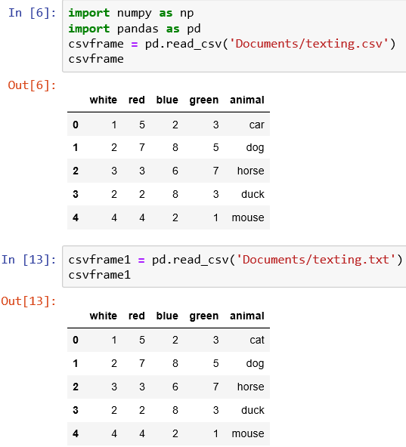
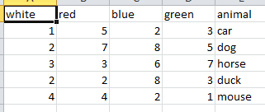
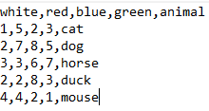
Reading Data in CSV or Text files
Most common operation for data analysis is to read the data contained in a .CSV file of even a text file.
To achieve the, we must import the following libraries numpy and pandas in our Jupyter Notebook
The read_csv() function will read the content of the .csv file and convert it to a dataframe object.
Original texting.csv and texting.txt files as seen in the spreadsheet and notepad

Slide 10
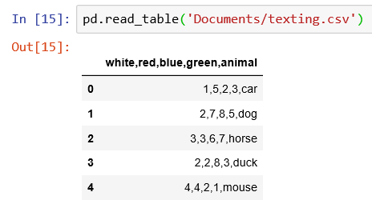
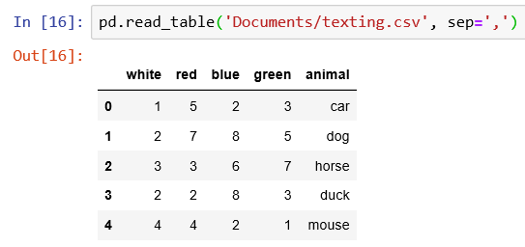
Reading Data in CSV or Text files
When using read_table() function to read a csv or txt file, specify the delimiter otherwise, the data will not be in a tabulated format.
Output of read_table() function with specified delimiter
Output of read_table() function without specifying the delimiter

Slide 11
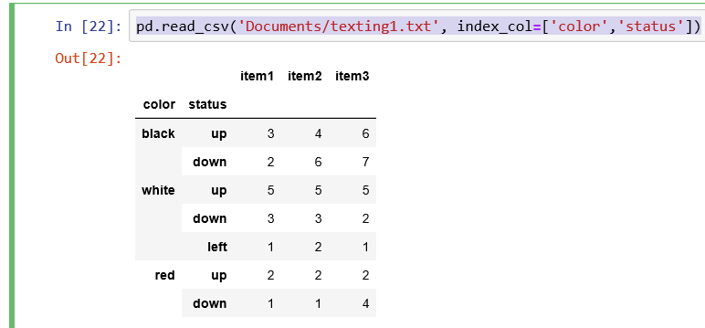
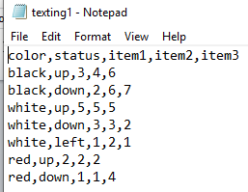
Reading Data in CSV or Text files
pd.read_csv('Documents/texting.csv', header=None): This will tell pandas to assign the default name to the columns.
You can specify the names directly by assigning a list of labels to the name options pd.read_csv('Documents/texting.csv', names=[‘white’,’red’,’blue’,’green’,’animal])
Create a dataframe with a hierarchical structure by extending the functionality of the read_csv()function by adding the index_col option.
Original Hierarchical data

Slide 12
Using RegExp to Parse TXT files
Sometimes the files on which to parse the data do not show separators such as comma or a semicolon.
Regular expressions can be used as criteria for value separation.
. | Single character, except newline
\d | Digit
\D | Non-digit character
\s | Whitespace character
\S | Non-whitespace character
\n | New line character
\t | Tab character
\uxxxx | Unicode character specified by the hexadecimal number xxxx

Slide 13
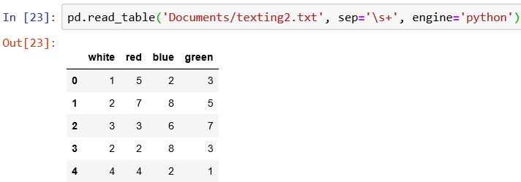
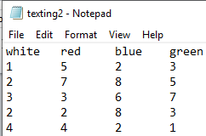
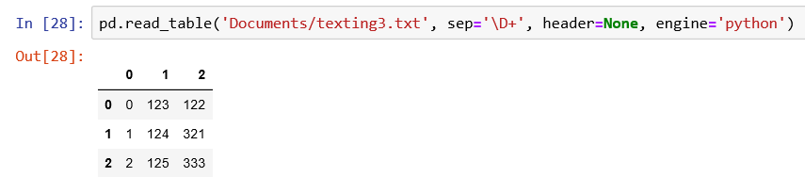
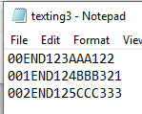
Using RegExp to Parse TXT files - Examples
This example extract the numeric part from a texting3.txt file. Header option = None because the column heading is not in the texting3.txt file.

Slide 14
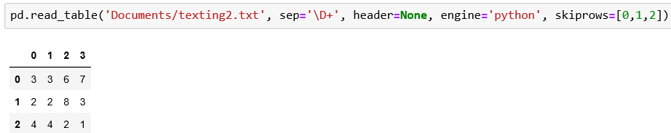
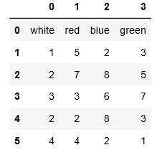
Using RegExp to Parse TXT files - Examples
With the skiprows option, you can exclude the lines you want.
Original texting2.txt file dataframe
texting2.txt file dataframe after skipping the first three rows

Slide 15
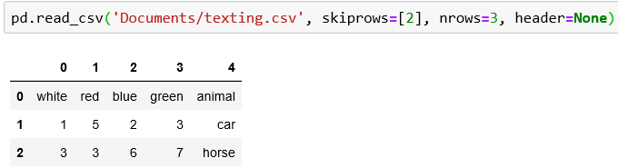
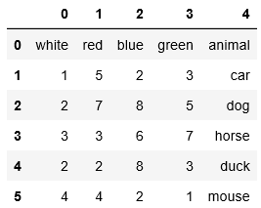
Reading TXT Files into Parts
To read only a portion of the file, you can specify the numbers of lines on which to parse. You can use the nrows and skiprows options.
Original dataframe
Dataframe after using nrows and skiprows

Slide 16
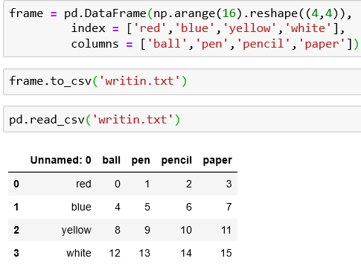
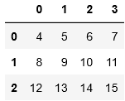
Writing Data in CSV
to_csv() : Function used to write the data contained in a dataframe to a csv file.
The index and header to False options are used to remove the default indexes and columns that are marked on the file by default.

Slide 17
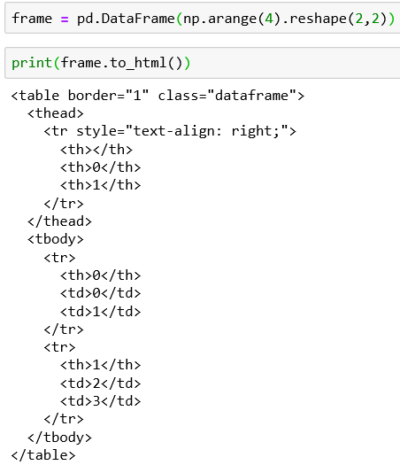
Reading and Writing HTML & Excel Files
to_html() function will convert a dataframe into an HTML table.
read_html() function returns a list of dataframes even if there is only one table.
to_excel() function to convert a dataframe into a spreadsheet on Excel.
read_excel() read the data contained in the excel file and convert it into a dataframe

Slide 18
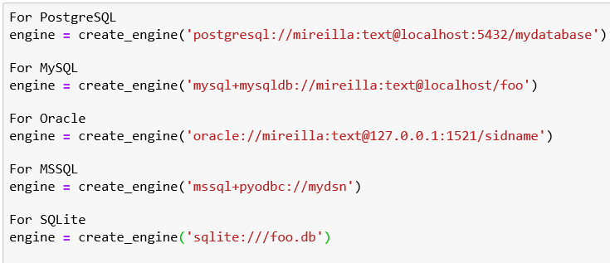
Interacting with Databases
pandas.io.sql module provides a unified interface independent of the DB called sqlalchemy. This interface simplifies the connection mode, regardless of the commands will be always be the same.
The create_engine() function is used to make a connection.
Example of code for connecting different databases.

Slide 19
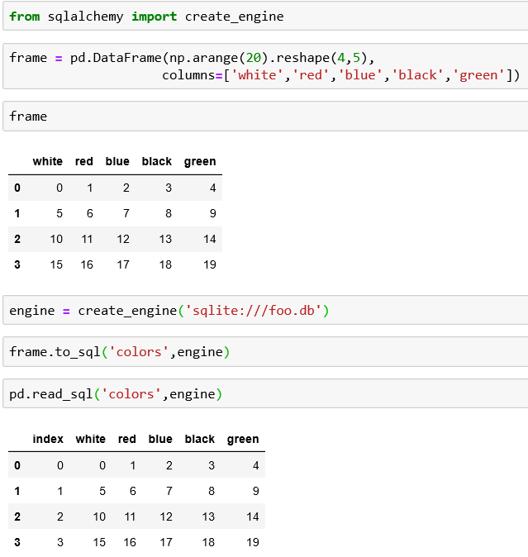
Interacting with Databases – SQLite3
Create a dataframe that will be used to create a new table on the SQLite3 database
Implement the connection to the SQLite3 database
Convert the dataframe
Read the database with the read_sql() function with the name of the table and the engine

